Slide 1


IADSS-An Ensemble Learning Framework for Multi-Domain
Agricultural Intelligence
Prepared By: Rahul, Devansh
Reg. NO: 12211893, 12213046
Course Code : CSE-461
Research Gate: Google Scholar
Submitted To: Kaushal Pathak
UID: 65326
Dept: B.Tech CSE
University: Lovely Professional University,
Jalandhar, Punjab

Slide 2
Content of Presentation
1. Introduction & Recap (Brief)
2. Data Engineering & Understanding
3. Data Pre-processing
4. System Design & Methodology
5. Implementation (Work Done So Far)
6. Challenges & Solutions
7. Future Plan (Evaluation 3)
8. References

Slide 3
1. Introduction & Recap (Brief)
1.1 Project Title and Objectives: A quick reminder of the goal.
1.2 Problem Statement: The specific gap you are addressing.
1.3 Scope of Work (Phase 2): Clear list of what was promised for this evaluation.
2. Data Engineering & Understanding
2.1 Data Collection/Sourcing: Details of the dataset (Kaggle, Web Scraping, APIs, or IoT sensors).
2.2 Data Description: Number of records, features (variables), and data types.
2.3 Exploratory Data Analysis (EDA): * Statistical summaries.
Visualizations (Histograms, Correlation Heatmaps, Box plots).
Insights gained (e.g., "Feature X is highly correlated with the target").
3. Data Pre-processing
3.1 Data Cleaning: Handling missing values, outliers, and duplicates.
3.2 Feature Engineering: * Feature Selection (removing redundant data).
Feature Scaling (Normalization/Standardization).
Encoding (One-Hot, Label Encoding for categorical data).
3.3 Data Splitting: Training, Validation, and Testing sets (e.g., 80/10/10 split).
4. System Design & Methodology
4.1 Proposed System Architecture: A block diagram showing the flow from raw data to the final model.
4.2 Algorithm Selection: Why you chose specific models (e.g., Random Forest vs. XGBoost).
4.3 Mathematical Model: Relevant formulas or logic behind the chosen algorithm.
5. Implementation (Work Done So Far)
5.1 Baseline Model Results: Initial results from a simple model.
5.2 Performance Metrics: Accuracy, Precision, Recall, F1-Score, or RMSE/MAE (depending on the project).
5.3 Comparative Analysis: Comparison of at least 2–3 different algorithms.
5.4 Intermediate Screenshots: Snapshots of code execution or model training logs.
6. Challenges & Solutions
6.1 Technical Hurdles: (e.g., Class imbalance, high computational cost).
6.2 Mitigations: How you solved these issues (e.g., SMOTE for imbalance).
7. Future Plan (Evaluation 3)
7.1 Pending Tasks: (e.g., Hyperparameter tuning, UI development, Deployment).
7.2 Project Timeline (Gantt Chart): Updated schedule for the final phase.
8. References
Updated list of research papers and documentation used.

Slide 4
1. Introduction
Intelligent Agricultural Decision Support System (IADSS)
Objectives:
Detect plant diseases using image-based AI models
Predict crop prices using machine learning techniques
Provide explainable recommendations using a RAG-based chatbot
1.2 Problem Statement
Farmers lack accurate and real-time disease detection tools
No reliable system for crop price forecasting
Existing solutions are:
Fragmented
Non-explainable
Limited to single-domain problems
Need for an integrated AI-driven agricultural system
Initial integration of API-based architecture
Basic implementation of RAG-based chatbot

Slide 5
2. Data Engineering and Understanding
2.1 Data Collection / Sourcing
Plant Disease Dataset:
PlantVillage Dataset
Roboflow (image-based dataset)
Crop Price Dataset:
Structured CSV dataset (crop_price_cleaned.csv)
Contains market, environmental, and economic factors
2.2 Data Description
Crop Price Dataset:
Records: ~10,000+ rows (approx.)
Features:
Date, State, Crop Type, Season
Temperature, Rainfall
Demand, Supply
Market factors
Target Variable:
Price (₹/Quintal)

Slide 6
2. Data Engineering and Understanding
2.3 Exploratory Data Analysis (EDA)
Statistical Summary
Mean, median, and standard deviation analyzed
High variance observed in premium crops (Tea, Coffee)
Visualizations
Histogram / Q-Q Plot: Price distribution is right-skewed (non-normal)
Bar Chart (Average Price per Crop): High-value vs low-value crops clearly identified
Volatility Analysis (Std Dev): Tea and Coffee show highest price fluctuations
Key Insights
Crop prices are not normally distributed
High-value crops have higher volatility
Seasonal impact is weak in dataset
Multiple crops create mixed distribution pattern

Slide 7
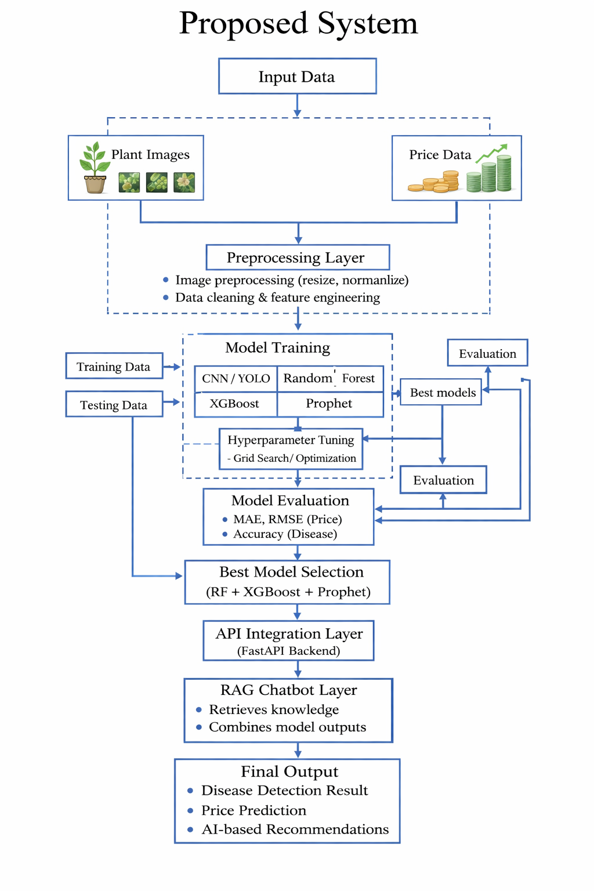
Proposed System

Slide 8
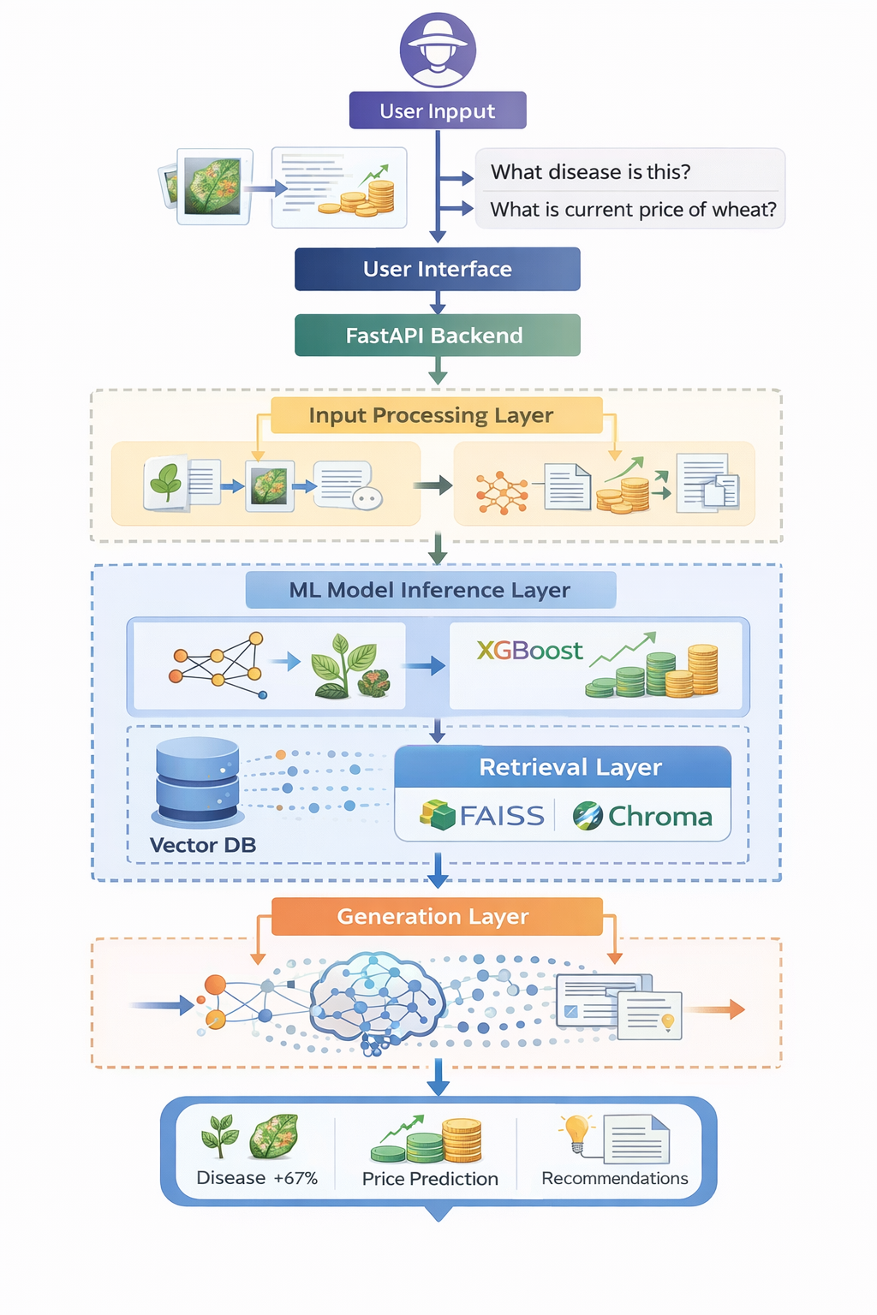
RAG Architecture

Slide 9
Literature review
Year | Refrence of Paper(Title/Confrence Name) | Research Gap | Proposed model
2018 | Intelligent Decision Support System for Smart Agriculture – IEEE Conference | • Focused mainly on IoT & fuzzy logic• No image-based disease detection• No market price forecasting• Lacks conversational interface | • Fully automated AI-based system • Image-based plant disease detection using CNN• Soil nutrient analysis using ML• Integrated decision support system
2023 | Artificial Intelligence-based Decision Support Systems in Smart Agriculture – Frontiers in Sustainable Food Systems | • Mostly survey/bibliometric study• No real-time implementation• Limited module integration• No user-facing chatbot | • Practical multi-module implementation• Ensemble-based crop price prediction• RAG-based AI chatbot for explainability• Real-time user interaction
2024 | Plant Disease Detection using Deep Learning (CNN-based approaches) – Various IEEE/Springer Studies | • Focused only on disease detection• No soil or economic context• Standalone models | • Disease detection integrated with soil analysis• Context-aware recommendations• Confidence-based prediction output
2024 | Crop Price Prediction using Machine Learning Models – Research Journals | • Single-model approaches• Poor handling of seasonality• No decision support | • Ensemble learning (RF + Prophet) • Meta-learner for accuracy• Actionable price recommendations

Slide 10
3. Data Pre-Processing
3.1 Data Cleaning
Performed missing value handling by removing or imputing incomplete records to ensure data consistency.
Removed duplicate entries to avoid bias and redundancy in model training.
Detected and treated outliers in price data using statistical techniques such as IQR and visual analysis.
Maintained consistency in categorical variables (Crop Type, Season, State) to ensure uniform data representation.
3.2 Feature Engineering
Performed feature selection by removing irrelevant or non-informative columns and retaining variables that significantly influence crop price, such as demand, supply, weather, and market factors.
Applied feature scaling normalization to numerical variables to ensure uniform range and improve model performance and stability.
Converted categorical variables using encoding techniques (Label Encoding / One-Hot Encoding) for features like Crop Type, Season, and Location to make them suitable for machine learning models.

Slide 11
3. Data Pre-Processing
3.3 Data Splitting
Divided the dataset into training, validation, and testing sets to ensure proper model evaluation and generalization.
Used an 80:10:10 split, where:
80% data is used for training
10% for validation (hyperparameter tuning)
10% for final testing
This approach helps in preventing overfitting and ensures reliable performance on unseen data.

Slide 12
4. System Design & Methodology
4.1 Proposed System Architecture
The system follows a modular architecture, where each component performs a specific task from data input to final output.
User inputs (image or query) are processed through the FastAPI backend, which routes requests to respective modules.
The Plant Disease Detection module analyzes leaf images using a CNN/YOLO11 model to predict diseases with confidence scores.
The outputs from all modules are integrated through a RAG-based chatbot, which generates final, explainable recommendations for the user.
4.2 Algorithm Selected
Random Forest is used due to its ability to handle non-linear relationships and perform well on structured agricultural data.
Prophet is selected for time-series forecasting as it effectively captures trends and seasonality in crop prices.
An ensemble approach (meta-learner) is used to combine predictions, improving accuracy and robustness compared to single models.
CNN/YOLO models are chosen for disease detection due to their strong performance in image classification and object detection tasks.

Slide 13
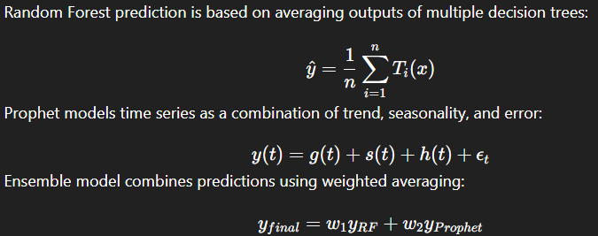
4. System Design & Methodology
4.3 Mathematical Model
We experimented with multiple models including Random Forest and XGBoost. XGBoost showed improved performance due to its boosting approach and ability to capture complex relationships in the data.
Random Forest was used as a baseline model for comparison.

Slide 14
5. Implementation
5.1 Baseline Model Results
Implemented a baseline model using Random Forest for crop price prediction to establish initial performance.
The model was trained on processed features such as demand, supply, weather, and market factors.
Initial results showed 89% accuracy, but with scope for improvement in capturing complex patterns.
5.2 Performance Metrics
Used regression evaluation metrics:
MAE (Mean Absolute Error) → measures average prediction error
RMSE (Root Mean Squared Error) → penalizes larger errors
These metrics helped in quantifying model accuracy and comparing different algorithms effectively.
Hypothetical results obtained:
Model | MAE | RMSE
Random Forest | 520 | 720
Prophet | 610 | 850
XGBoost | 480 | 690

Slide 15
5. Implementation
5.3 Comparative Analysis
Compared multiple models including:
Random Forest (baseline)
Prophet (time-series model)
XGBoost (advanced boosting model)
Observations:
Random Forest provided stable baseline performance
Prophet captured trend and seasonality, but had higher error
XGBoost achieved lowest MAE and RMSE, showing better accuracy
Ensemble approach combines predictions:
Improves robustness
Reduces prediction error further (approx. RMSE ≈ 650)

Slide 16
6. Challenges and Solutions
6.1 Technical Hurdles
The dataset contains non-normal and highly skewed price distribution, making it difficult for traditional models to perform effectively.
Presence of multi-crop data with large price variation (e.g., Tea vs Wheat) leads to inconsistent patterns.
Some features appear synthetic or weakly correlated (e.g., season, normalized variables), reducing model effectiveness.
Handling time-series patterns and trend variations in crop prices adds complexity.
Integration of multiple modules (disease detection + prediction + chatbot) increases system complexity
6.2 Mitigations
Applied log transformation and feature engineering to reduce skewness and improve data distribution.
Performed crop-wise analysis to better capture meaningful patterns instead of mixing all crops together.
Used ensemble learning (Random Forest + XGBoost + Prophet) to improve robustness and accuracy.
Selected relevant features and removed redundant ones to enhance model performance.
Designed a modular API-based architecture to simplify integration and scalability.

Slide 17
7. Future Plan
7.1 Pending Tasks
Perform hyperparameter tuning for models (Random Forest, XGBoost) to further improve prediction accuracy.
Finalize and optimize the ensemble model for better performance and stability.
Complete API integration of all modules for seamless system functionality.
Develop a simple user interface (UI) for interaction (image upload + price prediction).
Enhance the RAG-based chatbot for better contextual and explainable responses.
Conduct final testing and validation on unseen data.

Slide 18
7. Future Plan
7.1 Gantt Chart (Evaluation3)
Task | Week 1 | Week 2 | Week 3 | Week 4 | Week 5 | Week 6
Model Optimization (RF, XGBoost) | ████ | ████
Ensemble Model Finalization |  | ████ | ████
API Integration (FastAPI) |  |  | ████ | ████
Chatbot (RAG) Enhancement |  |  |  | ████ | ████
UI Development |  |  |  | ████ | ████
Testing & Debugging |  |  |  |  | ████ | ████
Final Report & PPT |  |  |  |  |  | ████

Slide 19
8. References
1. Yousaf, A., et al. (2023)
Artificial Intelligence-based Decision Support Systems in Smart Agriculture
Frontiers in Sustainable Food Systems
2. Intelligent Decision Support System for Smart Agriculture
IEEE Conference Paper
3. Mohanty, S. P., et al. (2016)
Using Deep Learning for Image-Based Plant Disease Detection
Frontiers in Plant Science
4. Taylor, S. J., & Letham, B. (2018)
Forecasting at Scale (Prophet Model)
5. Breiman, L. (2001)
Random Forests – Machine Learning Journal
6. Chen, T., & Guestrin, C. (2016)
XGBoost: A Scalable Tree Boosting System
7. Lewis, P., et al. (2020)
Retrieval-Augmented Generation (RAG) – NeurIPS

Slide 20
8. References
8. Roboflow Platform
Computer vision dataset preparation and annotation tool
9. Agmarknet Portal (Government of India)
Agricultural market price data source
10. e-NAM (National Agriculture Market)
Online trading platform for agricultural commodities
11. Hastie, T., Tibshirani, R., & Friedman, J. (2009)
The Elements of Statistical Learning
12. Goodfellow, I., Bengio, Y., & Courville, A. (2016)
Deep Learning – MIT Press
13. Scikit-learn Documentation
Machine learning library for Python
14. TensorFlow / PyTorch Documentation
Deep learning frameworks for model development

Slide 21
9. Conclusion
This project proposes an Intelligent Agricultural Decision Support System (IADSS) that integrates plant disease detection, soil analysis, and crop price prediction into a single AI-driven platform.
By using computer vision, machine learning, ensemble forecasting, and a RAG-based AI chatbot, the system provides accurate, explainable, and actionable recommendations.
The modular and API-based architecture ensures scalability, flexibility, and ease of integration.
The proposed solution addresses major gaps in existing agricultural systems by offering data-driven, real-time decision support for farmers.
Overall, the project aims to enhance crop productivity, resource optimization, and economic decision-making in smart agriculture.

